Slide 1
Final Project - Wine Quality
By : Shay Korhorn, AJ Rallo, and Anthony Streib
5/2/2024

Slide 2
Introduction
Our Dataset
Wine Quality
Goals For Our Project
Correlations, using trained linear regression
Sugar & Wine Quality
Alcohol Content & Wine Quality

Slide 3
Data Source
Source of Our Dataset
Kaggle
Overview
Variables
Types
Unique Characteristics
Notes:
Acidity, Sugar, Chlorides, Alcohol Content, Sulfates

Slide 4
Cleaning the Data and Data Information
Data Cleaning
Data Information
Our Process
12 columns and 1600 rows
11 independent variables per wine type
1 dependent variable corr. independent
11 numerical and 1 categorical variable

Slide 5
Our Code and Explanation
CLICK LINK
https://github.com/AjdaRallo/DS160_Final_Project_AJR-SEK/blob/main/Final%20Project%20Aj%20Rallo%2C%20Shay%20Korhorn%2C%20and%20Anthony%20Streib%20%20(1).ipynb

Slide 6
Results
Sugar Level’s Affect on Overall Wine Quality
Alcohol Content’s Affect on Overall Wine Quality
https://github.com/AjdaRallo/DS160_Final_Project_AJR-SEK/blob/main/Final%20Project%20Paper.pdf

Slide 7
Data Results Info
Our r-value=0.634964566
The mse value=0.390025
Sugar vs Quality/Sugar Coefficient: 0.006564311042026366
Alcohol vs Quality/Alcohol Coefficient: 0.2818895674038428

Slide 8
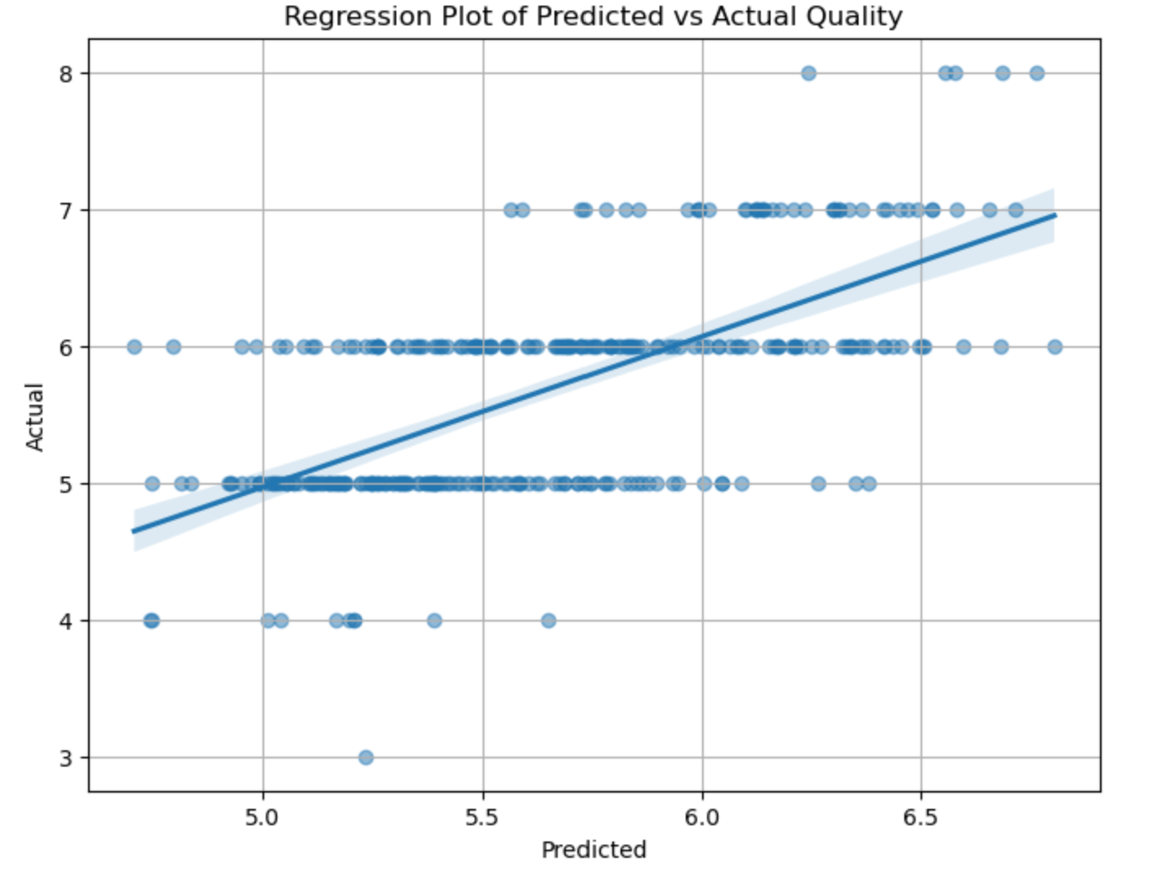
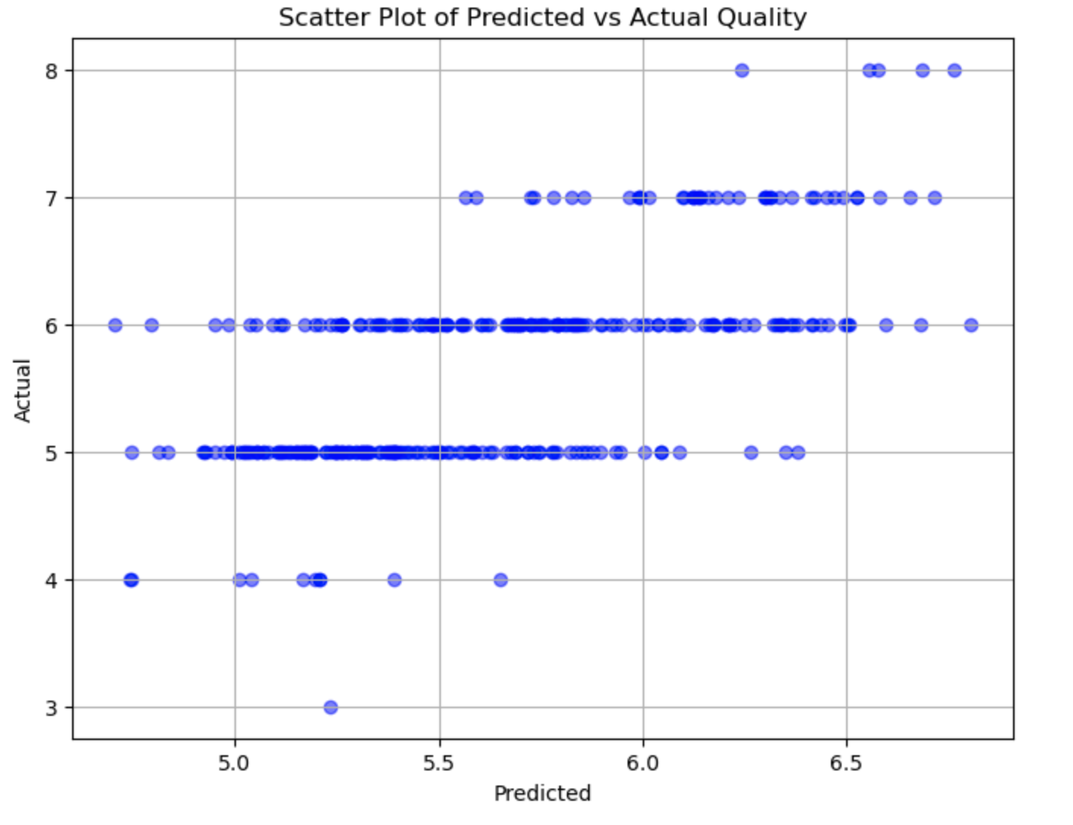
Graphs-predicted vs actual

Slide 9
Analysis
Methods
Cleaning, Using variables,
Technique and Tools
Pandas, Matplotlib, Sklearn, and Statsmodels.api
Hypothesis
Notes:
Did not have to clean as it was not needed to prepare our dataset for further analysis.
Our techniques or tools we used were pandas and matplotlib.
Our hypotheses consist of whether or not sugar affected the wine quality, due to the fact that sugar usually makes all foods taste better, sweeter. Our second hypothesis consists of whether or not the varying alcohol content changes the overall quality of the wine, in our case we decided that not too much and not too little alcohol would be best for the wine quality, an even balance between taste and the strength of the alcohol content.

Slide 10
Discussion
Reflection
Real World Application
Notes:
To reflect and look back at our project, I say that we did a great job in analyzing the data, creating our hypotheses and creating different visuals to show correlation between two variables. We were lucky enough to find a dataset that did not require much, if any, cleaning and preprocessing, so we were able to go ahead and get to work much quicker than expected.
As for potential real-world application of the insights we have gained, we can use the correlations found from sugar vs wine quality and alcohol content vs wine quality, which can help us if we are ever in the predicament of choosing the best wine possible for consumption whether it be for a date with an important person, or potentially an important business dinner for your dream job.

Slide 11
Conclusion
Takeaways
Dataset
Variables
Our Project’s Objectives
Two Specific Hypotheses
Linear Regression
Correlation
Understanding Machine Learning and Linear Aggression
Notes:
Overall,

Slide 12
Q & A
Any Questions?

